Slide 1

Notes:
https://www.youtube.com/watch?v=yeoW-P5hf8U
Opening Hook: Welcome everyone! Let’s start with a honest question: How many of you truly, sincerely want to achieve more success than you currently have right now?
The Core Question: We all live in the exact same 24 hours a day, 7 days a week, 365 days a year. Yet, how do the world’s superachievers—the people who land on the cover of SUCCESS Magazine—manage to produce 10, 50, or 1,000 times more than the average person?
Purpose: Today, I’m going to share the distilled productivity secrets gathered from interviewing and studying the greatest business minds of our era—like Warren Buffett, Steve Jobs, and Richard Branson.

Slide 2
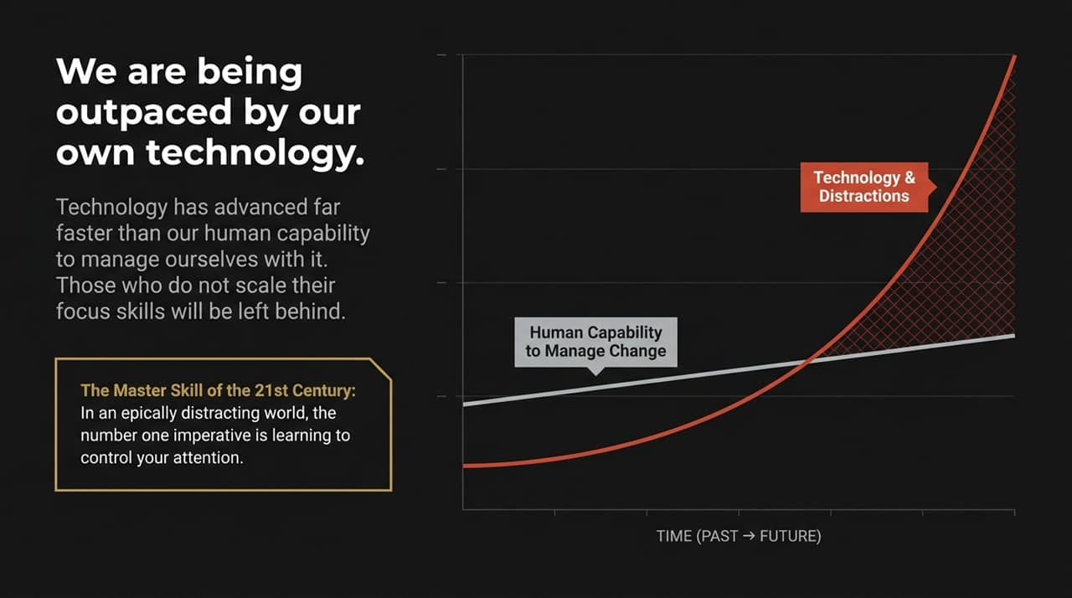
Notes:
The Myth of Hard Work: Most of us were raised to believe that the key to success is simply working harder and putting in longer hours. But brute force eventually hits a ceiling where you run out of hours and burn out.
The 4 Quadrants of Productivity:
Unengaged: Low time/effort and low results.
Over-Motivated / Unfocused: High effort consuming books and webinars, but zero execution and low results.
Overachiever (The Trap): Massive time and energy, high output, but high burnout and capped potential.
Superachiever: High results with minimal wasted time/effort.
Takeaway: Our goal today isn't to get you to work harder; it’s to transition you from an overwhelmed overachiever to a stunningly successful superachiever.

Slide 3
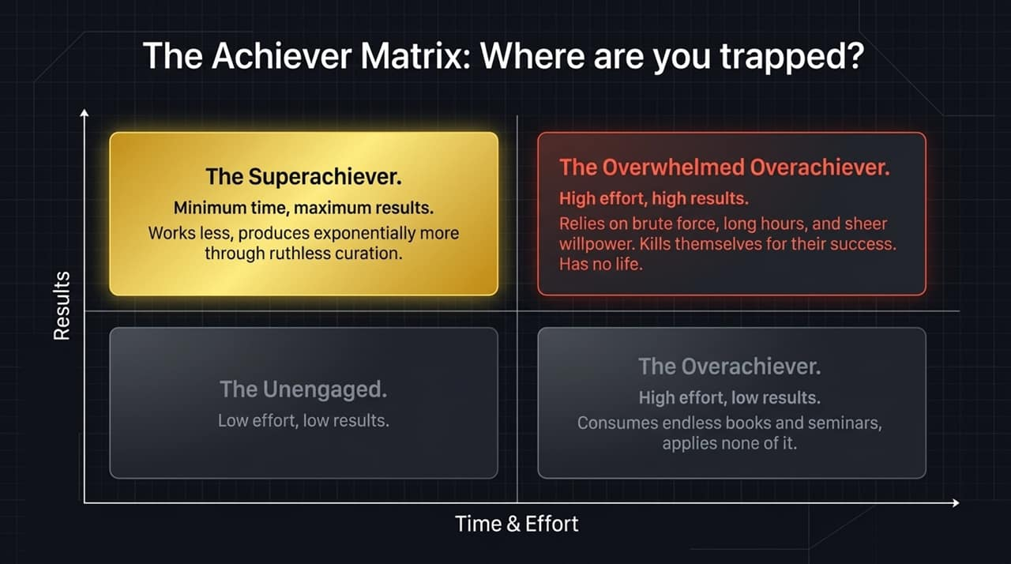
Notes:
Visual Analogy: Imagine someone walked up to the petty cash drawer in your office, pulled out $100 bills, and started lighting them on fire one after another. You’d tackle them out the front door! Yet that exact cash burn happens every day through unchecked distractions.
The Staggering Cost:
Organizations lose $10,000 per employee per year due to distractions.
As a nation, over $650 billion in net productivity is lost annually.
The #1 Skill of the 21st Century: The single most imperative skill today is learning to control your attention and guard your focus.

Slide 4
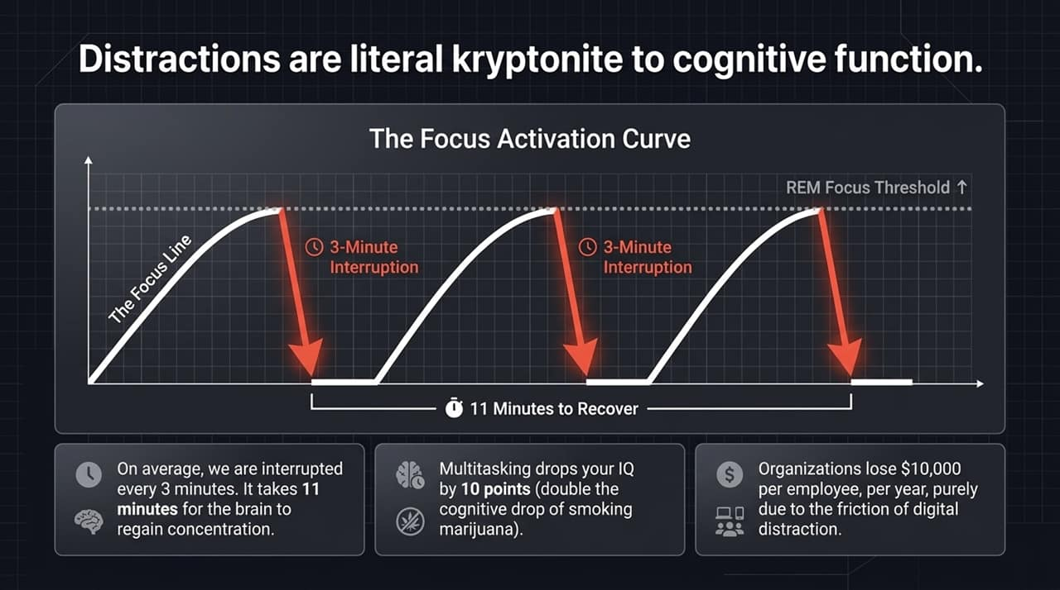
Notes:
The Exponential Curve: Technology advances at an exponential rate, far faster than human capability to naturally manage itself.
The Great Conundrum: Devices, emails, texts, and notifications are open windows in your environment. Without conscious skill development in attention control, technology will leave traditional workers overwhelmed and obsolete.
The Opportunity: Because most people won't scale their focus skills to match technology, those who do master focus will find it easier to stand out and dominate their market.

Slide 5
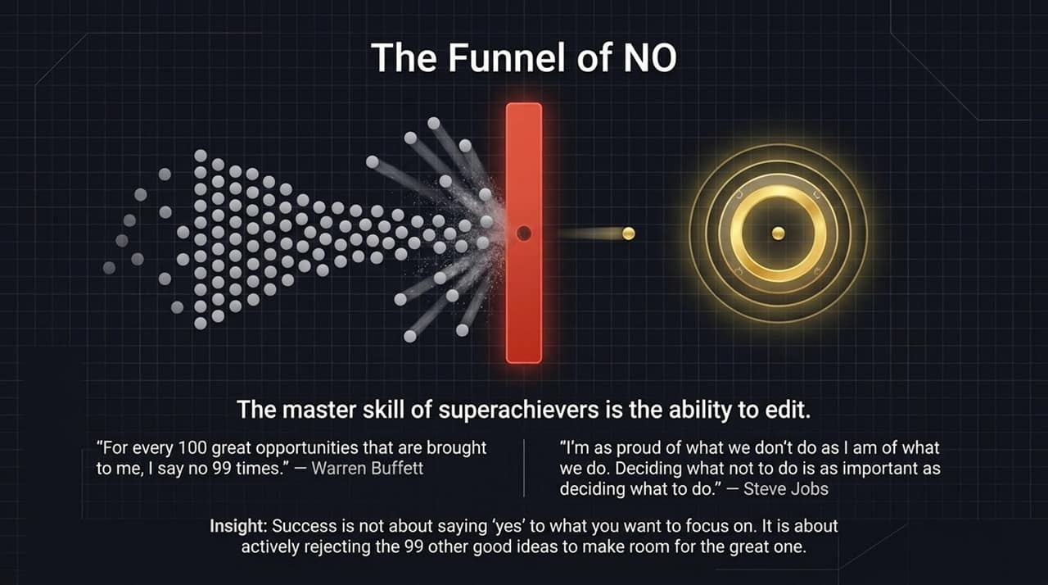
Notes:
The Grid Analogy: Walking into your office without a focus strategy feels like staring at a grid of hundreds of competing boxes—it gives you a headache and blurs your vision.
The Formula:
Gray Out: Remove/say no to 99% of line-item solicitations on your time.
Identify: Isolate the 3 vital boxes/priorities on the grid that actually matter.
Master: Deepen your skills and execution on those few priorities.
Summary: This 3-step formula is the exact difference between high performers and superachievers like Steve Jobs or Warren Buffett.

Slide 6
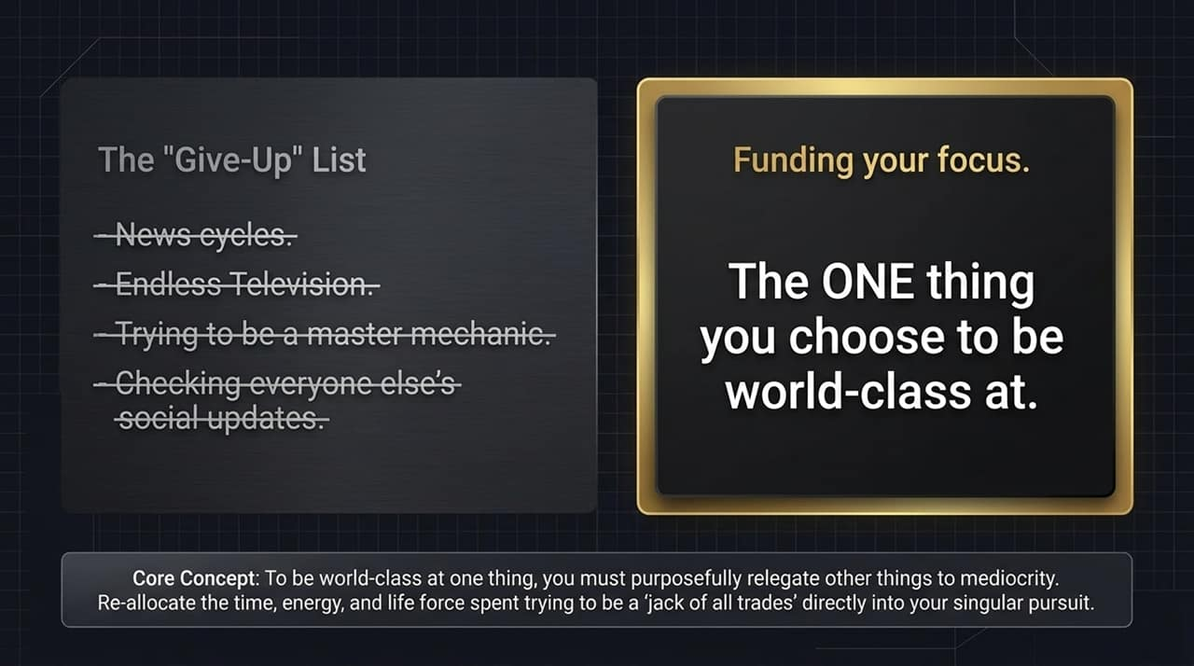
Notes:
Counter-Intuitive Truth: Superachievers don't succeed because of what they do; they succeed because of what they DON'T do. Saying "yes" is easy and makes us feel busy, valued, and needed.
The Warren Buffett Secret: Warren Buffett stated: "For every 100 great opportunities brought to me, I say NO 99 times." Very successful people say no to almost everything so they have time for what truly matters.
The Steve Jobs Perspective: Steve Jobs said he was as proud of what Apple didn't do as what they did, stating: "Focusing is about saying NO to the hundred other good ideas."

Slide 7
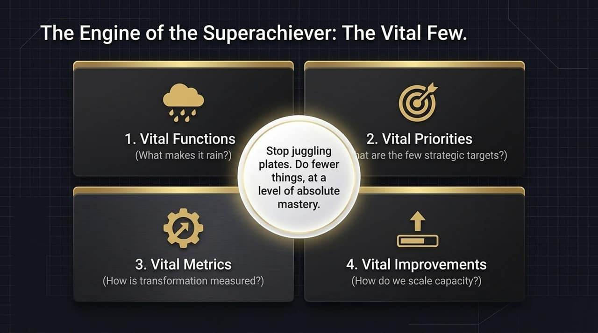
Notes:
Nike & Steve Jobs Story: When Mark Parker became CEO of Nike, Steve Jobs gave him one piece of advice: "Nike makes some of the best products in the world, but you also make a lot of crap. Just get rid of the crappy stuff and focus on the good stuff."
Wisdom Quotes:
Kenneth Cole: "Success has less to do with what we can get ourselves to do and more to do with keeping ourselves from doing what we shouldn't."
Peter Drucker: "There is nothing so useless as doing efficiently that which should not be done at all."
Call to Action: Look at your calendar from last week—what crappy or unnecessary tasks should you have said NO to?

Slide 8
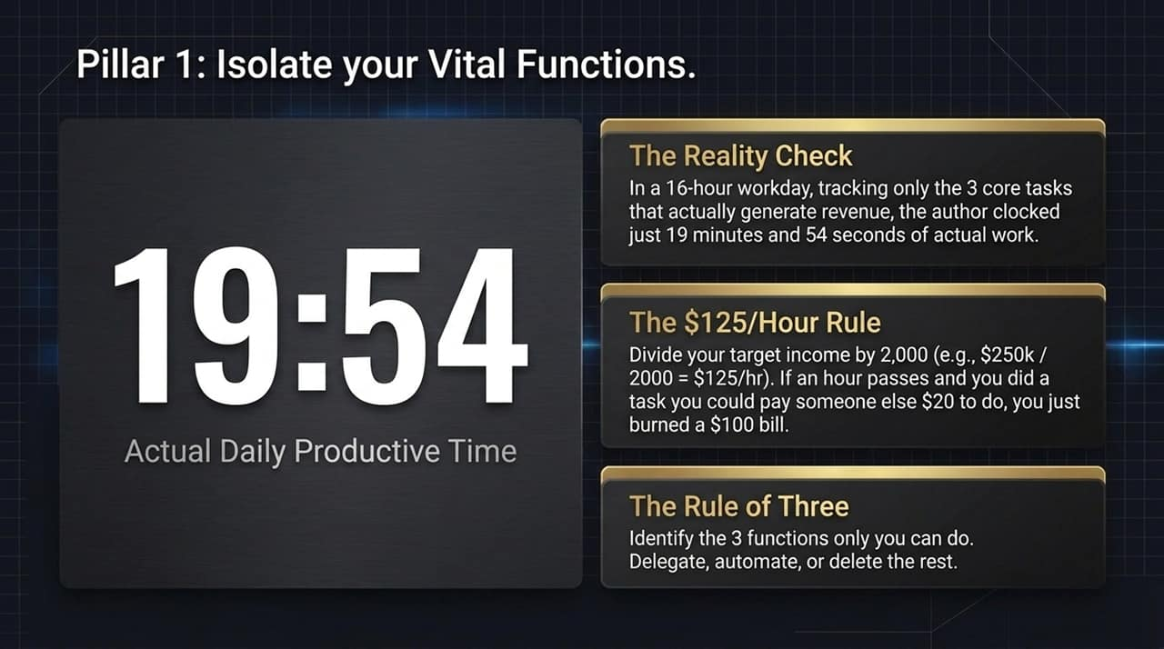
Notes:
World-Class Focus: It is better to be world-class at a few things than mediocre at many. History remembers figures like Edison, Ford, or Carnegie because they were world-class in one domain, even if they were mediocre or bad at other life areas.
The "Give-Up" List: To be great at your vital few, you must relegate other activities to mediocrity or eliminate them.
Personal Example: Eliminate low-yield distractions like news consumption, endless TV, or minor household tinkering to reallocate those hundreds of hours toward your core mastery.

Slide 9
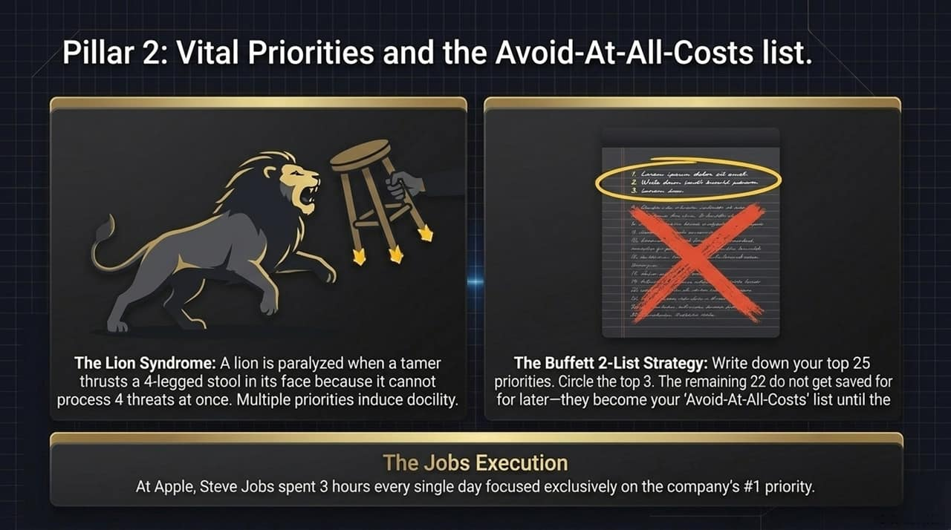
Notes:
Dr. Oz & Heart Surgery: Dr. Oz performs hundreds of heart surgeries, runs TV shows, and writes books because he only handles the vital few functions of surgery (the critical valve work) and delegates prep, cleanup, and routine tasks to a capable team.
The Real Estate Stopwatch Experiment: In real estate, out of 5,000 potential daily tasks, only 3 actually generate income: pitching listings, negotiating contracts, and prospecting.
The Eye-Opening Result: Tracking these 3 vital functions with a physical stopwatch during a 16-hour workday revealed only 19 minutes and 54 seconds of true vital work! Increasing vital time to just 1–2 hours daily will exponentially increase output.

Slide 10
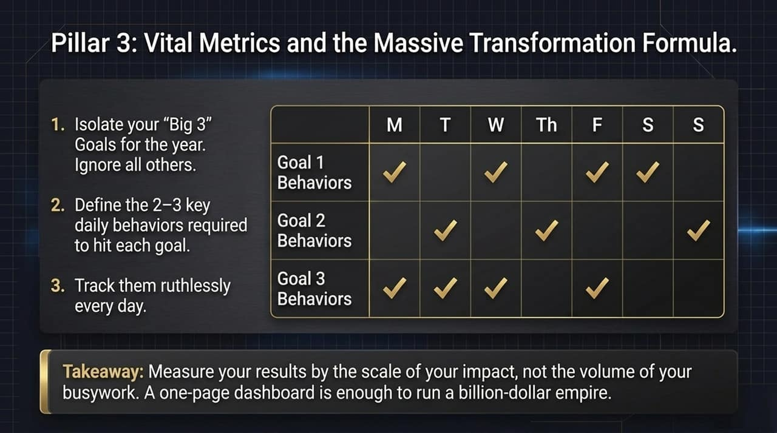
Notes:
Know Your Math: Income Goal ÷ 2,000 hours = Your Hourly Value.
$100k/yr = $50/hour
$250k/yr = $125/hour
$1M/yr = $500/hour
The Value Test: Ask yourself constantly: "Would I pay someone else $125/hour to do what I am doing right now?" If not, delegate or eliminate it.
Joel Osteen's "One Thing": Osteen realized his single highest-value contribution was his 22-minute Sunday message. By focusing almost his entire week on reading, writing, and practicing those 22 minutes, his reach grew to 40 million people.

Slide 11
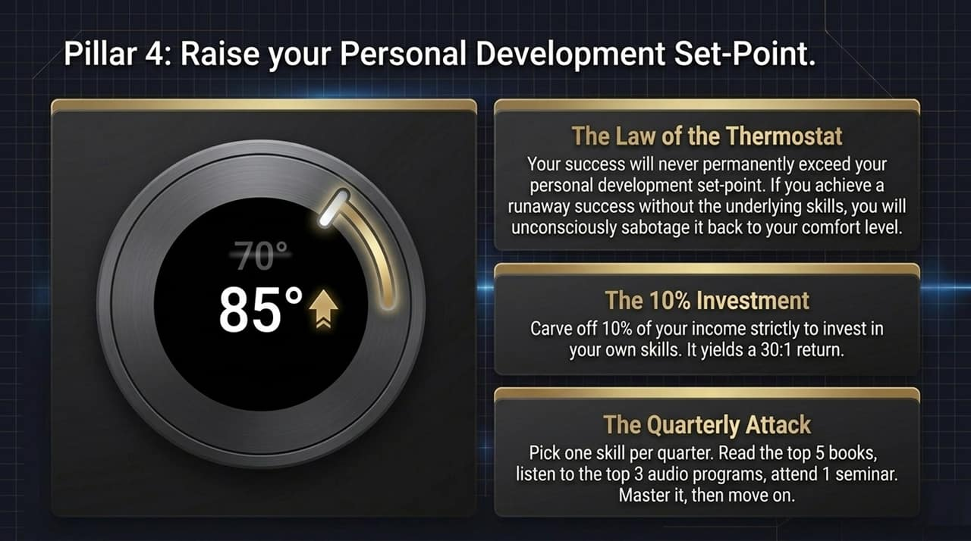
Notes:
The Lion Syndrome: A lion tamer controls a 800 lb lion using a four-legged stool. The lion tries to focus on all four legs at once, gets overwhelmed by competing focal points, and turns docile. Too many priorities create mental paralysis.
Branson's 3 Priorities: Richard Branson turned down $500,000 for a 1-hour speech because he was locked into 3 strategic priorities, and paid speaking was not one of them.
Buffett’s 25/5 Priority Rule:
Write down top priorities.
Circle the top 3.

Slide 12
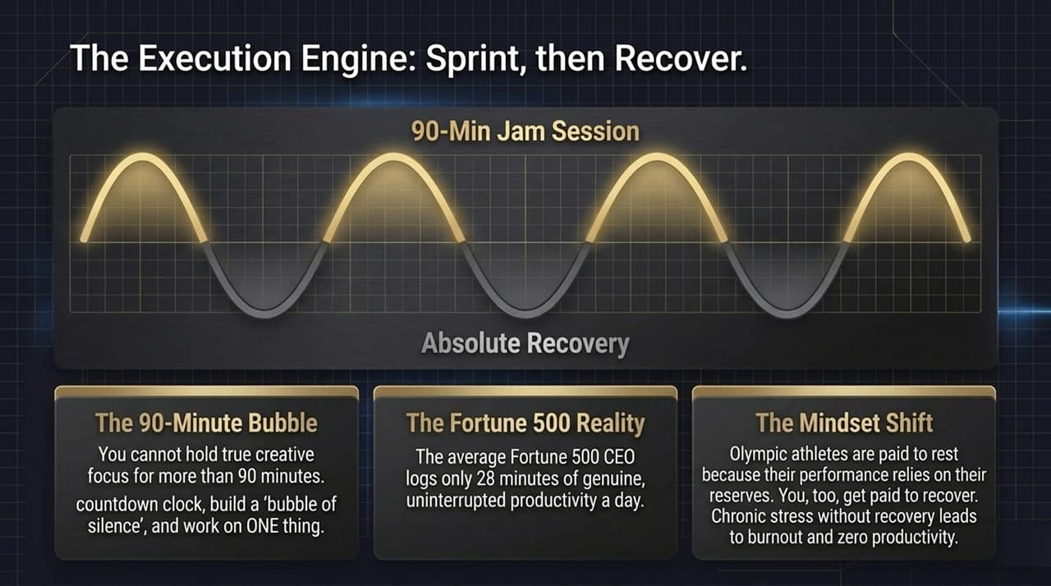
Notes:
Addiction to Distraction: We crave novel distraction because it provides relief from hard work and fulfills our desire to feel wanted (likes, emails, texts).
The Shocking Math:
Average worker is interrupted every 3 minutes.
It takes 11 minutes to regain deep cognitive focus.
REM Productivity: Just like sleep quality depends on uninterrupted REM cycles, work output depends on uninterrupted deep focus.
Multitasking Fallacy: Cognitive switching drops your IQ by 10 points—twice as much as being under the influence of marijuana (5 points)!

Slide 13
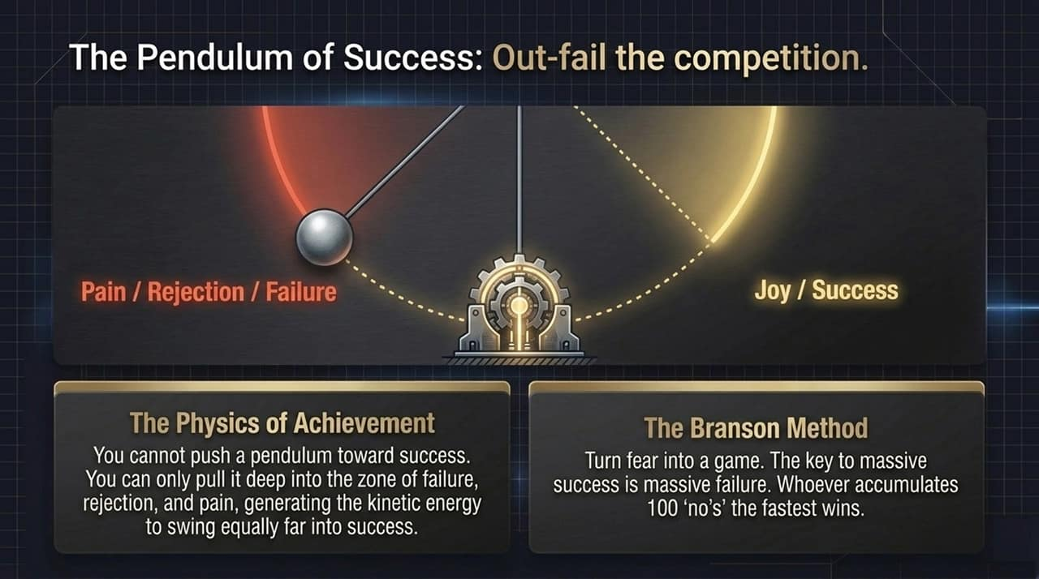
Notes:
The 28-Minute CEO Statistic: Fortune 500 CEOs average only 28 minutes of genuine uninterrupted focus per day.
The 90-Minute Jam Session:
Set a 90-minute countdown timer.
Build a "bubble of silence" (turn off notifications, close door).
Work exclusively on one single task.
Intermittent Recovery: Elite athletes train hard, but they win gold medals because they master recovery. You must view rest as an active requirement for high performance.

Slide 14
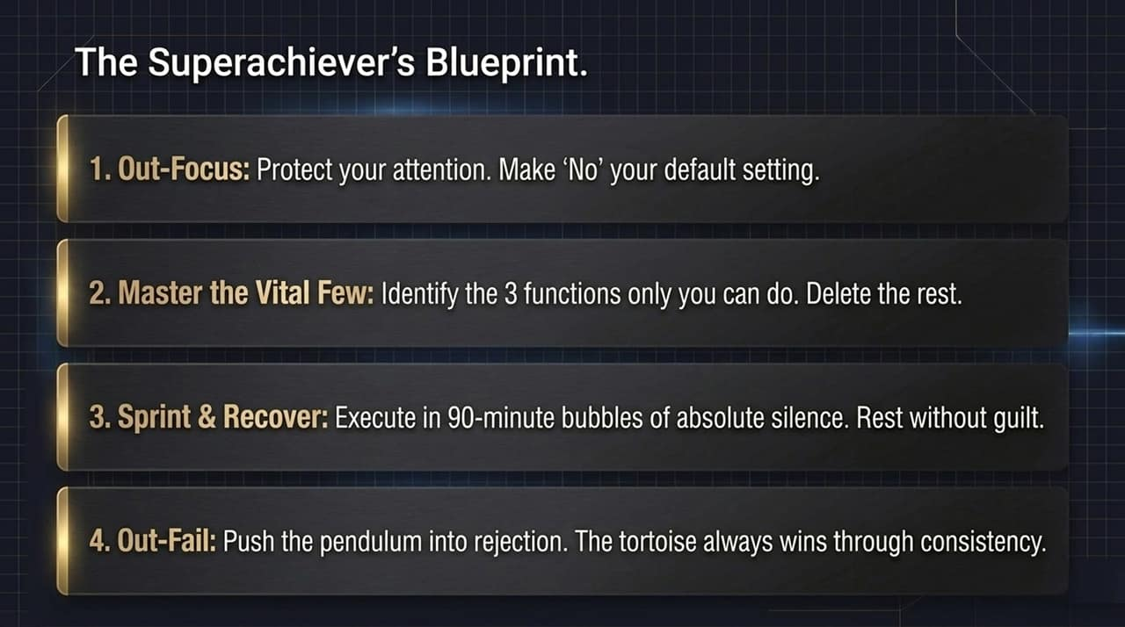
Notes:
Massive Transformation Formula:
Big 3 Goals: Narrow your yearly ambitions down to the 3 goals that would make this your best year ever.
Key Behaviors: Identify the 2–3 recurring actions required for each goal.
Daily Tracking: Track execution daily.
The Dashboard: Use a simple single-page tracking register. Check off whether you completed key behaviors each day to know immediately if you are on track or off track.

Slide 15
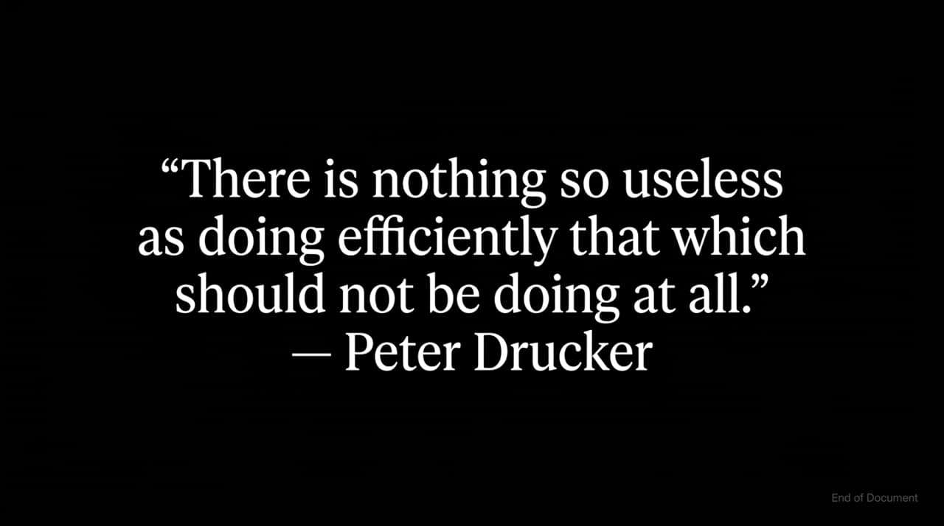
Notes:
The Thermostat Set Point: Everyone has an internal personal development set point. If lottery winners or businesses achieve results beyond their set point without growing internally, they inevitably revert back.
Jim Rohn Wisdom: "For things to change, you have to change. For things to get better, you have to get better."
The 1-1-5-3-1 Personal Growth Plan:
Focus on 1 primary goal & 1 key skill per quarter.
Read 5 top books, listen to 3 audio programs, and attend 1 seminar on that skill.
Invest 10% of your income back into your personal development.

Slide 16

Notes:
The Pendulum Analogy: Life is a pendulum. On one side is failure, rejection, and sadness; on the other is success, joy, and victory. You cannot pull the pendulum to the success side without pushing it equally high on the failure side.
Outfail Everyone: The key to fast-tracking success is accelerating your failure rate. Turn the pursuit of rejection into a game.
Final Summary Checklist:
Stop doing 99% of unproductive tasks.
Master your vital few functions, priorities, and metrics.
Outfocus, outlast, outgrow, and outfail the competition.

